Slide 1


Business Intelligence :
Qu’est-ce que
?

Slide 2
Business Intelligence &

Slide 3
Intelligence, n.f.
Business, n.m. activité consacrée aux affaires financières ou commerciales
capacité à rassembler ses capacités intellectuelles pour résoudre des problèmes
Business Intelligence
capacité à résoudre des problèmes dans un cadre financier ou commercial.

Slide 4



1980’s
1970’s
1969
Base de données
E. Codd

Slide 5



1989
« BI »
H. Dressner
2000’s
Besoins d’accessibilité de l’information

Slide 6


Power BI : un héritage
Naissance du terme BI
Evolution des besoins utilisateurs
Lancement projet Gemini
Power Pivot
Power BI
Excel v1
1e tableur
= le meilleur d’ et de

Slide 7
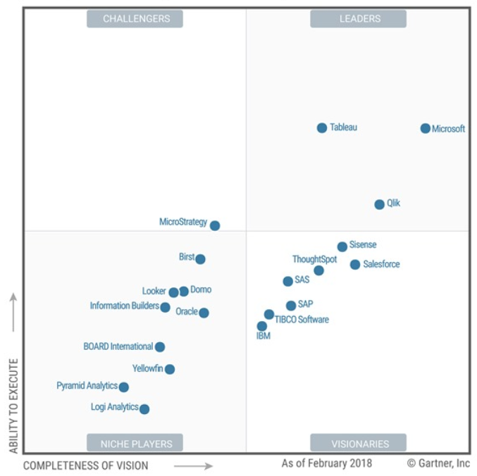

Slide 8
Exemple

Slide 9
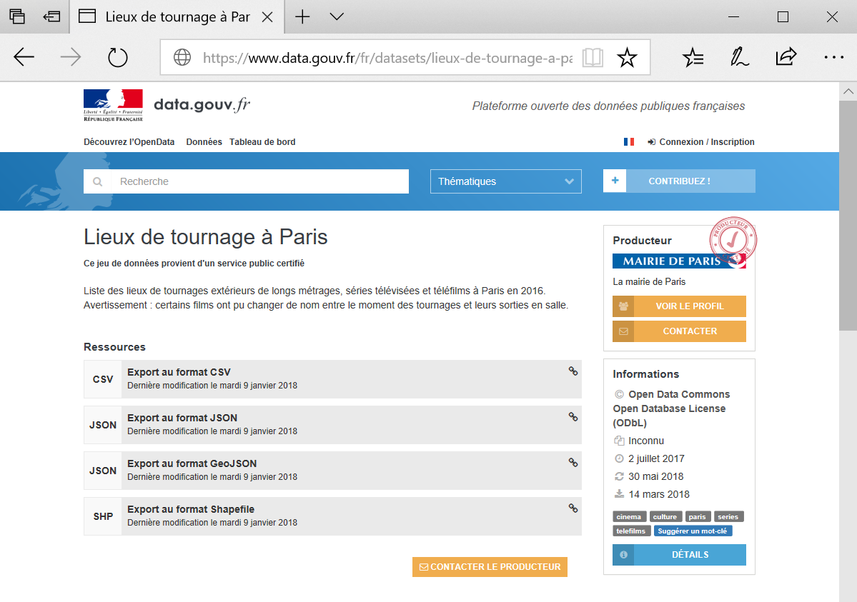
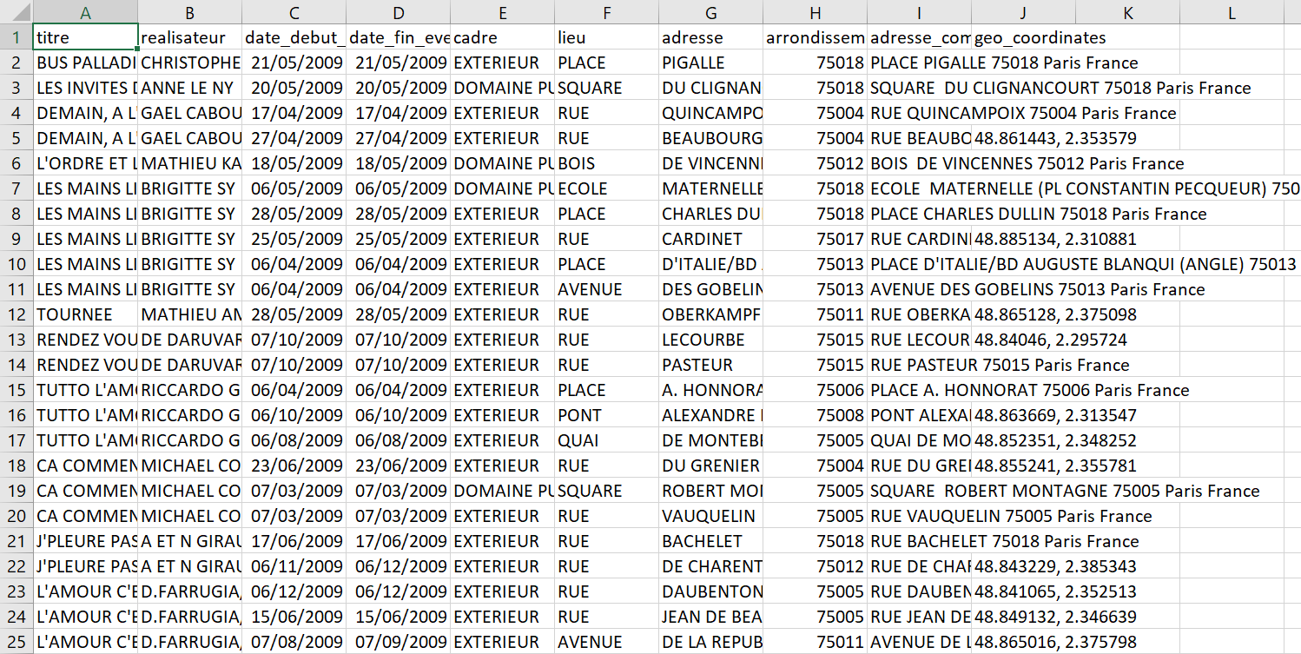
Notes:
Teaser / this is an example of an existing report developped with Power BI. I’ll show it to you in details, explain to you what i did and how.

Slide 10
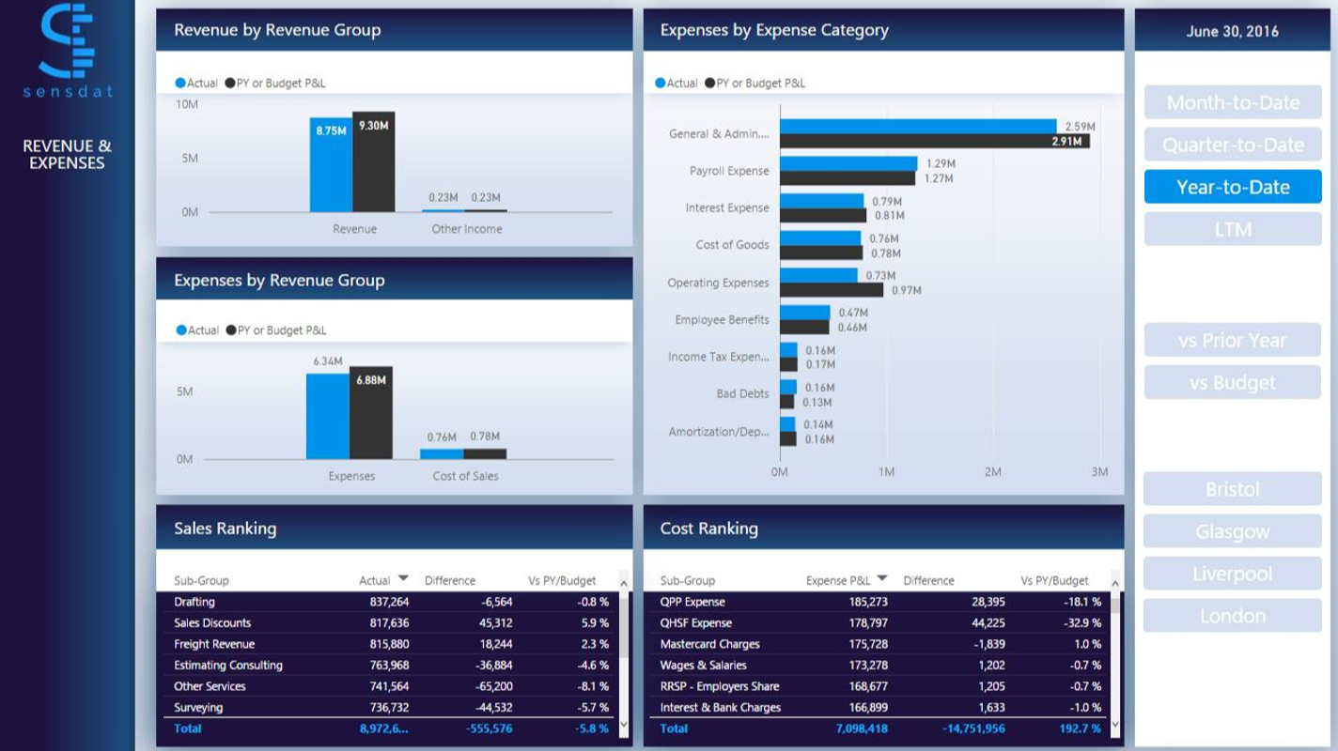

Slide 11
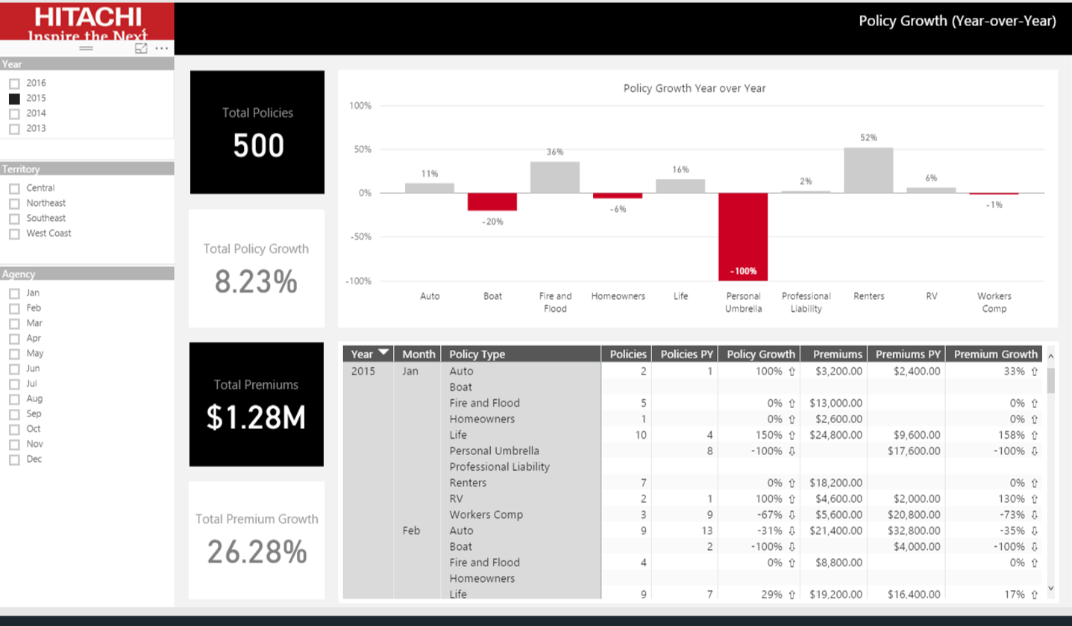

Slide 12
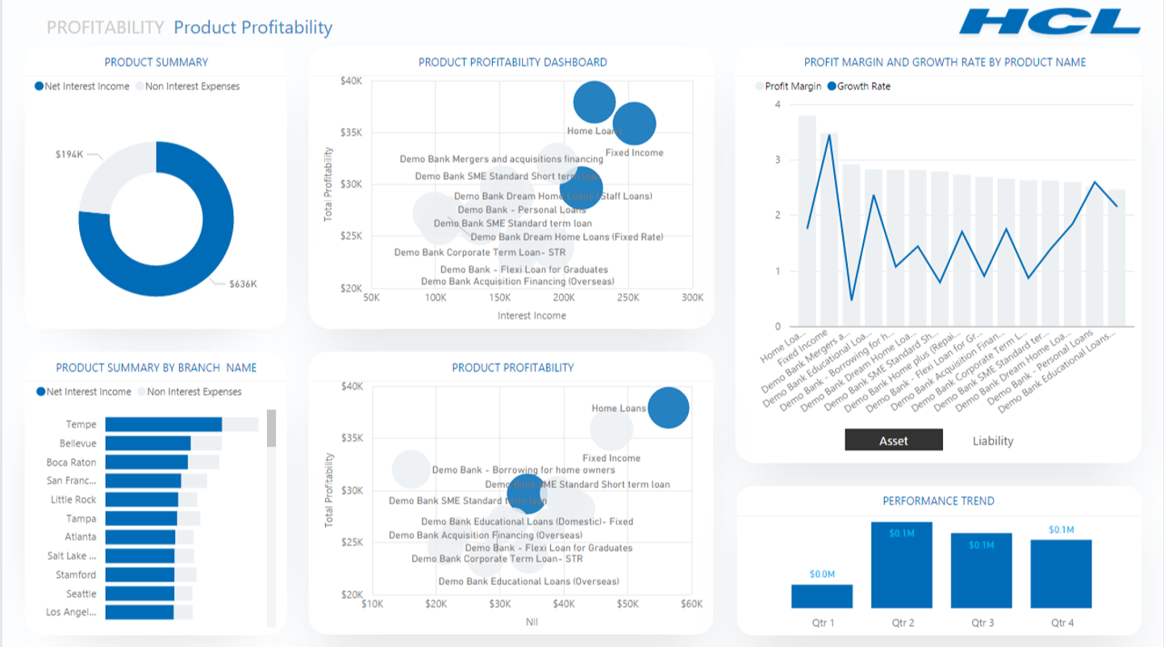

Slide 13
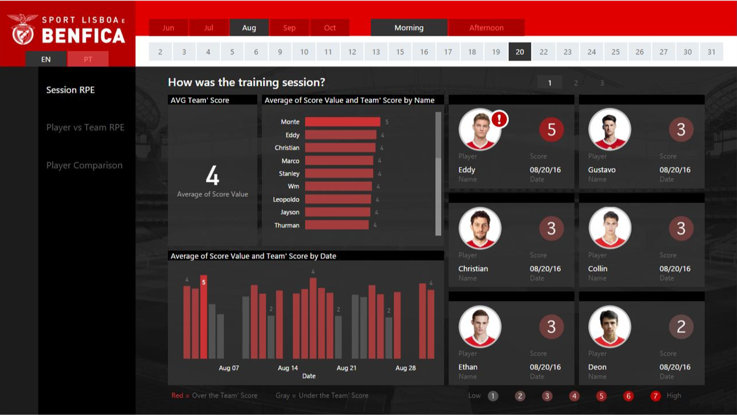

Slide 14
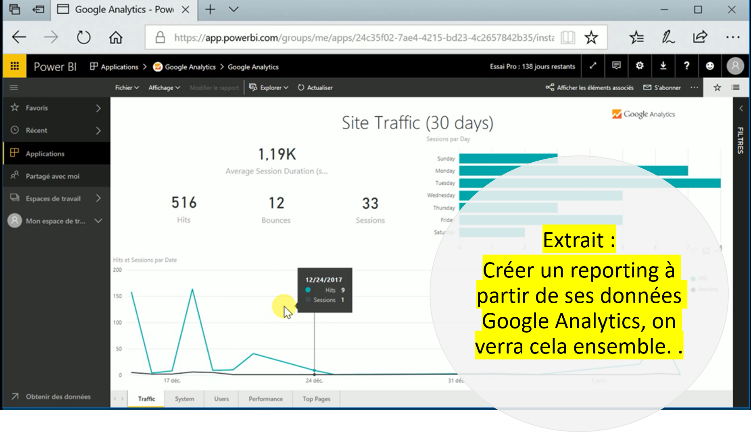

Slide 15
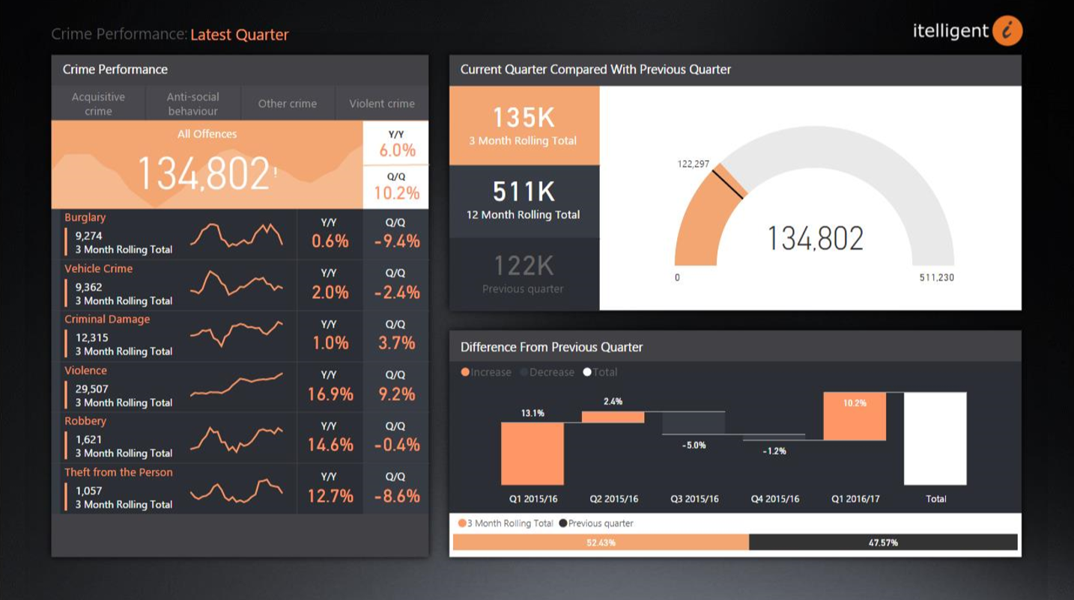

Slide 16
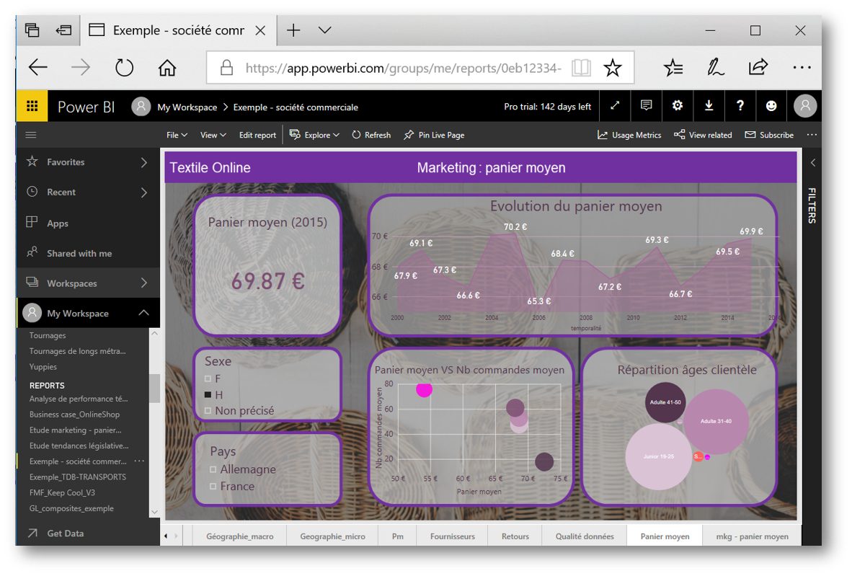

Slide 17
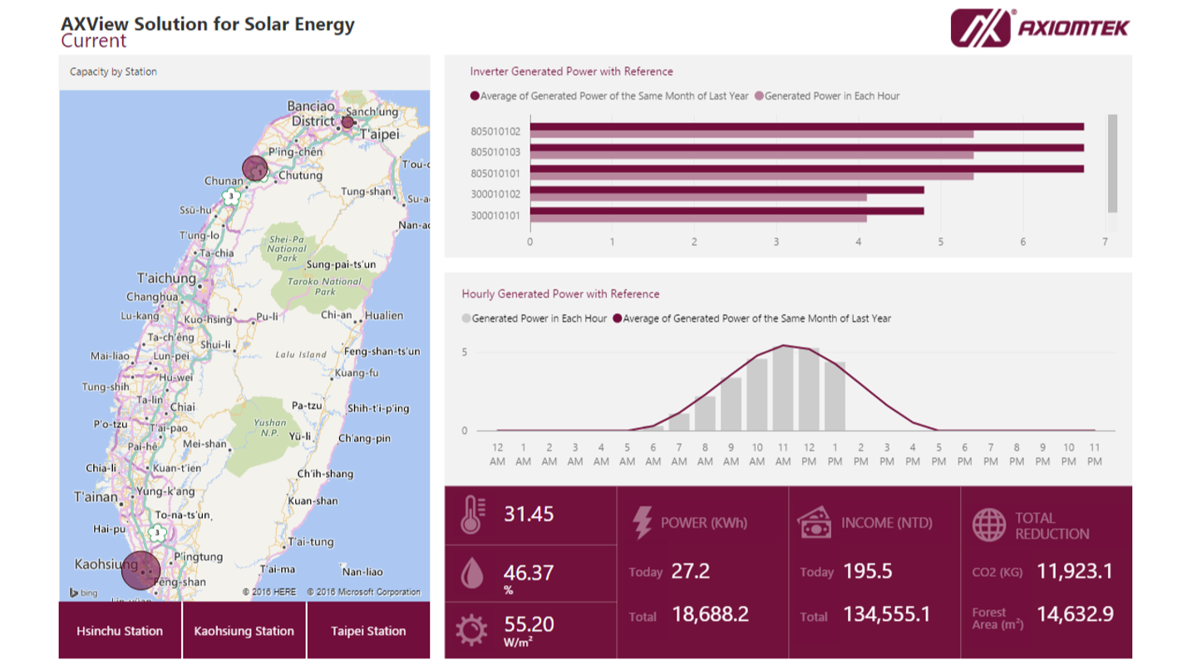

Slide 18
Fonctionnalités
Notes:
But beforehand, I need to tell you a bit more about PBI and explain to you what it does and how.
Sorry this part is a bit theoretical – but hang in there it will get practical very soon.

Slide 19

« Outil décisionnel de
Visualisation
Interactive
des
Données »
Notes:
French version = « outil décisionnel de visualisation intéractive des données ». ‘decisional’ component which might be more accurate than the english version.
To sum it up, it is a tool which enables you to extract information out of your data and summarize it.
Example of writing down the summary of a book, which words are not in order, within an hour.
>5M users in 2016…

Slide 20



3 outils majeurs
Desktop
Service
App
logiciel
site internet
application
D’où l’on construit nos visuels
D’où vous pouvez consulter, annoter et partager la solution

Slide 21
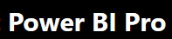



Package analytique
Portail de création de rapports en local
Intégrations de visuels à des sites web / applications

Slide 22
Partager
Analyser
Se connecter
Transformer
Visualiser
Calculer
Notes:
Provides non-technical business users with tools to… their data.

Slide 23


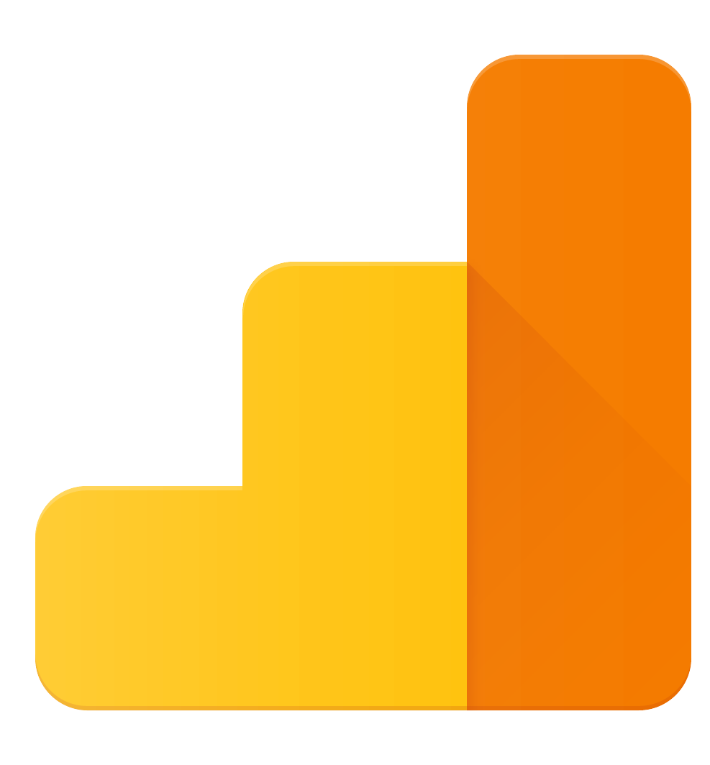


Service
Application
Desktop

Slide 24
Les licences

Slide 25
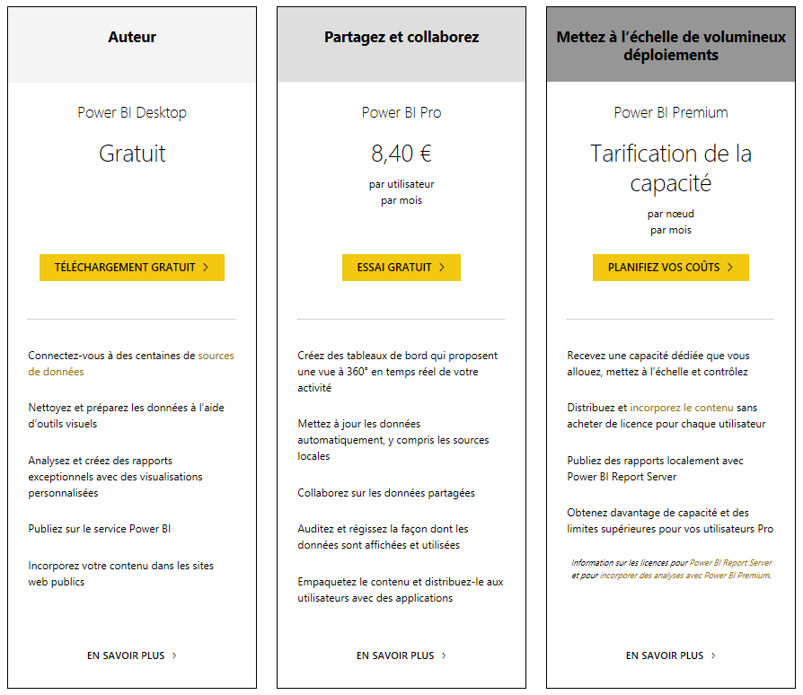
https://powerbi.microsoft.com/fr-fr/pricing/

Slide 26
Installation

Slide 27
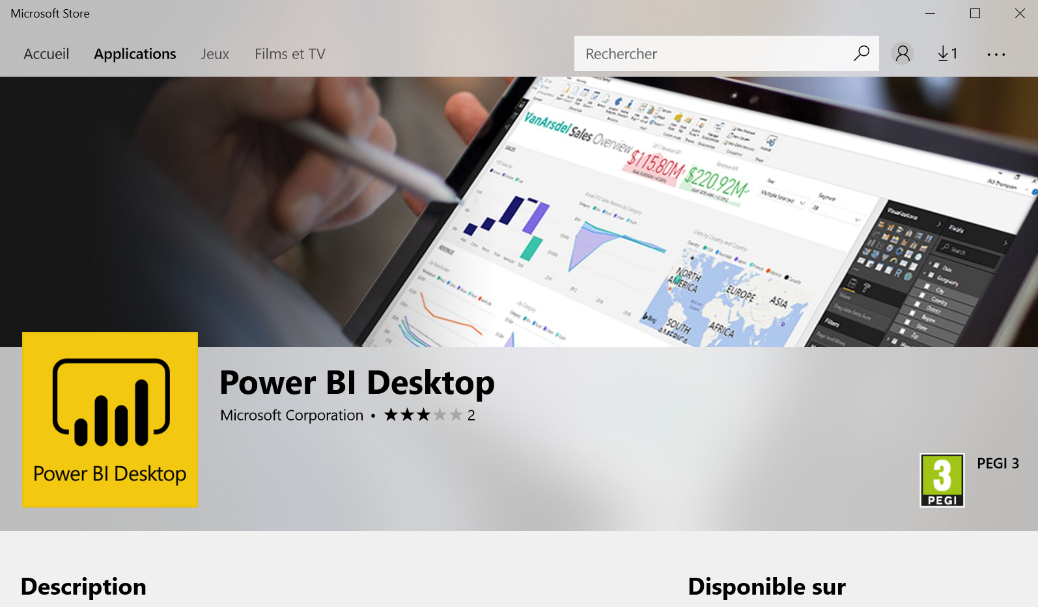
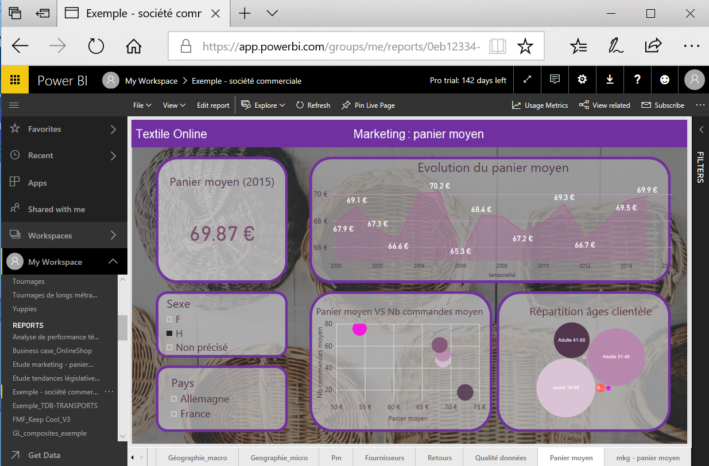

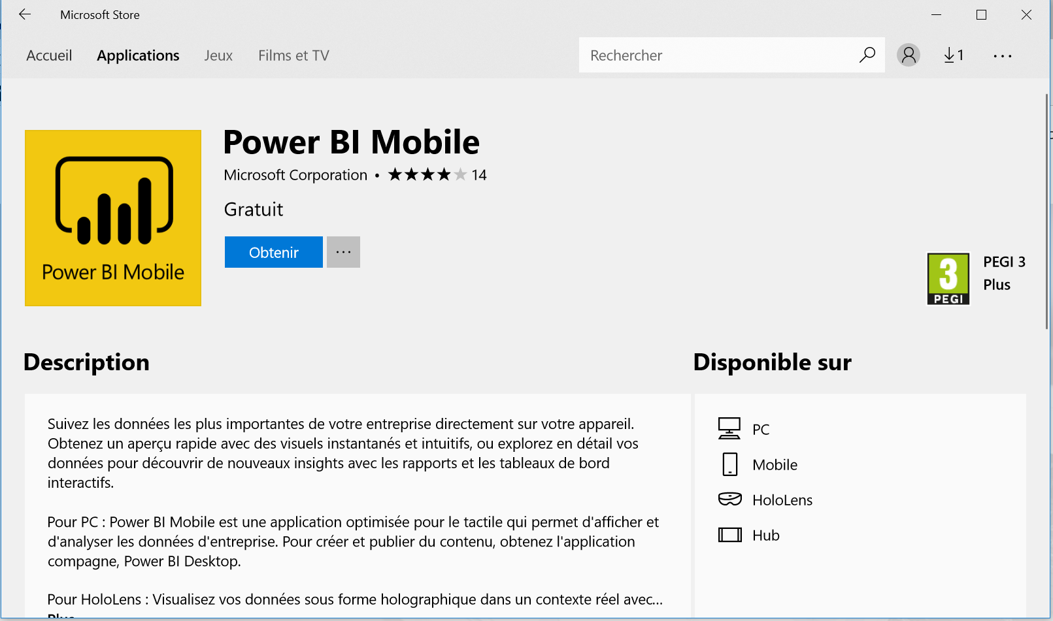
3)
PBI Service est accessible avec un compte PBI
2)
Créer un compte PBI depuis powerbi.microsoft.com
1)
Télécharger PBI desktop sur le Microsoft Store
4)
Télécharger l’application mobile, sur le Microsoft Store

Slide 28
Utilisation
Notes:
Let’s get more into the specifics of Power BI.
I’ll tell you how – in theory – you build reports = the process.
Again, this is a brief summary, I’ll try to make a long story short and cover the main steps.
I will apply this process to our business case = put it into practice. As I do, I will list the features which are valuable.

Slide 29
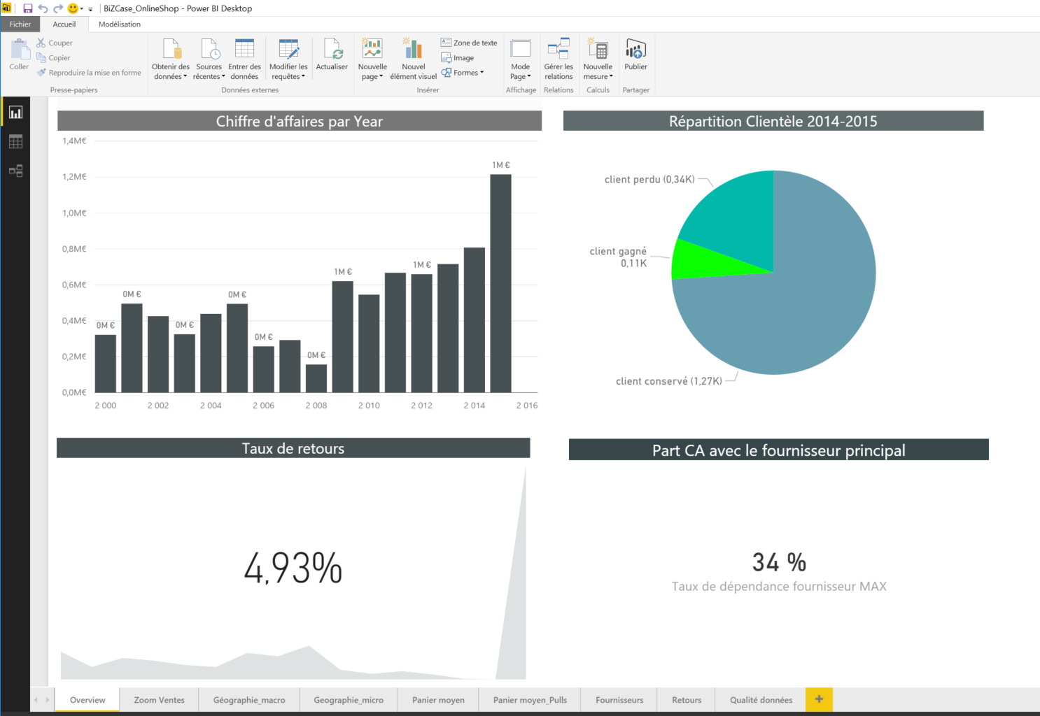



5 étapes
- Chiffre d’affaires
- Taux de performance
- …
3-
Création de mesures
4-
Visualisations dynamiques
2-Gestion des données
5-
Partage de la solution
Mise à jour des données et des informations
1-Connexion aux données
Suppression doublons
Ajout de colonnes calculées
…
Contrôles Qualité
Création et organisation des tables de données

Slide 30
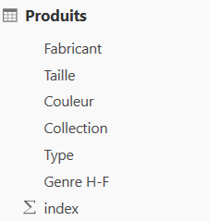

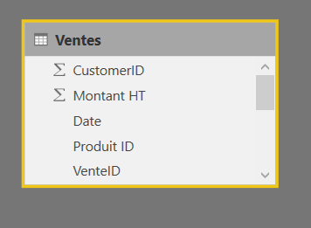
Etape 1
Se connecter
Etape 2
Gérer
Etape 3
Calculer
Etape 4
Visualiser
Etape 5
Partager
Charger les données

Slide 31
Etape 1
Se connecter
Etape 2
Gérer
Etape 3
Calculer
Etape 4
Visualiser
Etape 5
Partager
Créer le modèle relationnel de données
1
n

Slide 32
Etape 1
Se connecter
Etape 2
Gérer
Etape 3
Calculer
Etape 4
Visualiser
Etape 5
Partager
Effectuer des traitements sur ses données
Vente ID | Produit ID | Date | Montant | Client ID | Name
1 | A345 | 01/01/2018 | 25,00 | K24 | Jacquet
2 | ER45 | 01/01/2018 | 34,90 | K24 | MarCel
3 | G25 | 03/01/2018 | 142,74 | 353 | ?
4 | F56 | 04/01/2018 | 45,4 | 456 | X

Slide 33
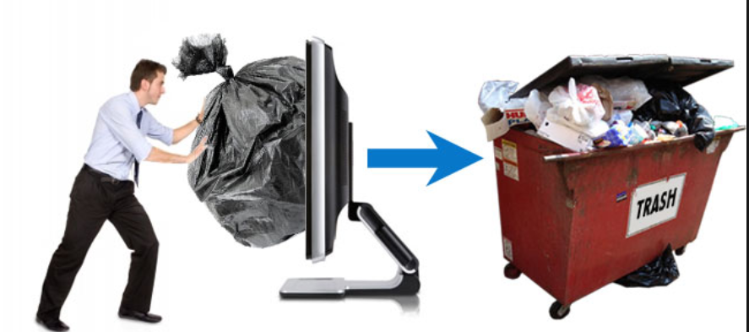
Etape 1
Se connecter
Etape 2
Gérer
Etape 3
Calculer
Etape 4
Visualiser
Etape 5
Partager
Contrôler la qualité de ses données

Slide 34
Etape 1
Se connecter
Etape 2
Gérer
Etape 3
Calculer
Etape 4
Visualiser
Etape 5
Partager
Type de calcul | Le calcul s’effectue | Langage
Colonne calculée | Ligne par ligne | DAX
Colonne personnalisée | Ligne par ligne. | DAX ou M (éditeur avancé)
Mesure | Sur une table, sur laquelle s’applique éventuellement des filtres. | DAX
XFunctions | Fonctions itératives : ligne par ligne puis total des lignes.

Slide 35
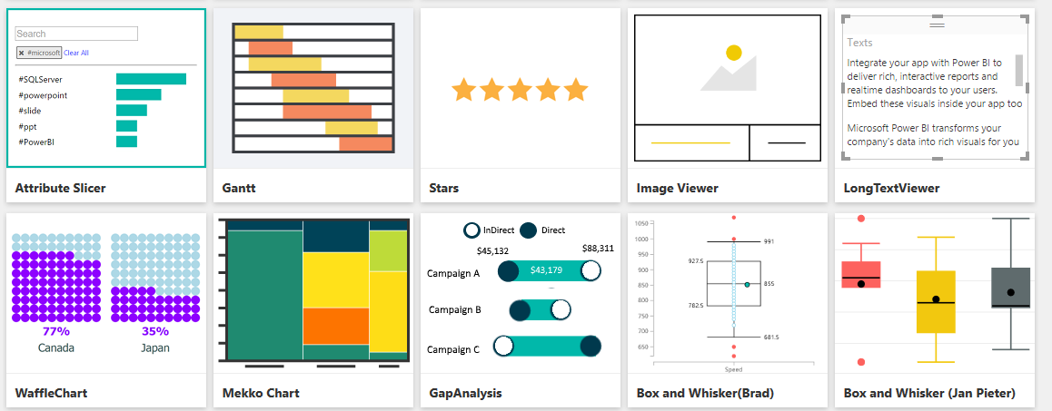
Etape 1
Se connecter
Etape 2
Gérer
Etape 3
Calculer
Etape 4
Visualiser
Etape 5
Partager
Mettre en place les visuels
classiques ou customisés

Slide 36
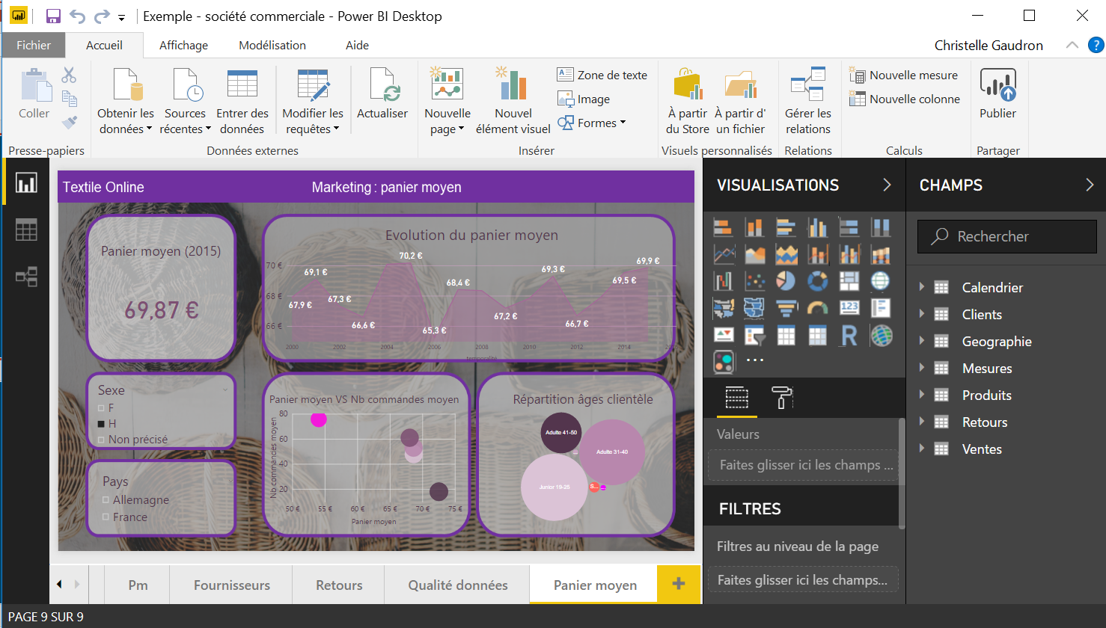
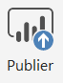



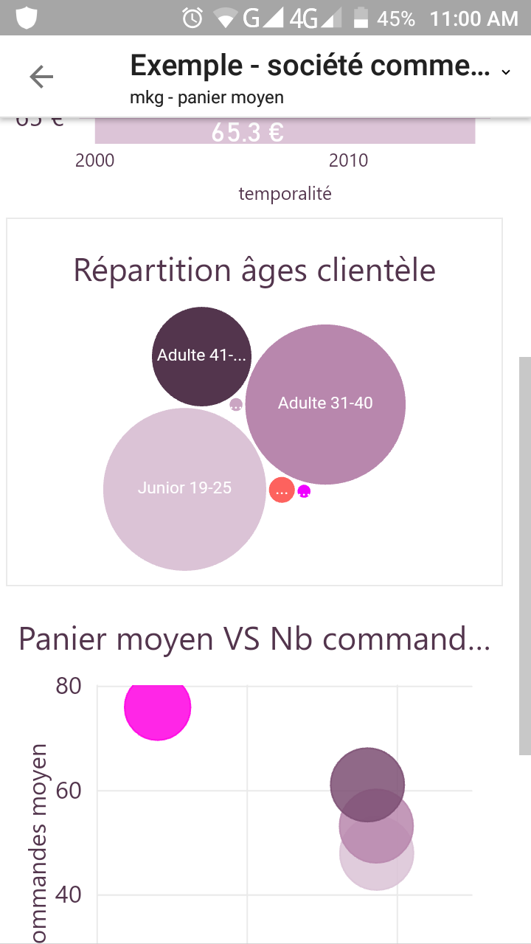



Etape 1
Se connecter
Etape 2
Gérer
Etape 3
Calculer
Etape 4
Visualiser
Etape 5
Partager
rapport
web
rapport
rapport
et
dashboard

Slide 37

Etape 1
Se connecter
Etape 2
Gérer
Etape 3
Calculer
Etape 4
Visualiser
Etape 5
Partager

Slide 38
En pratique
Notes:
Summary of 5 steps : connect, transform, calculate, visualize, share. Follow the steps. Prepare yourself before hitting the keyboard.
I build a report for Maurice and I want to show you how I did it.
I’ll take you with me behind the scenes.
As I do it, I’ll highlight the pros and couns of PBI.

Slide 39
Avant de commencer…
Notes:
Sources at my disposal = the current report (excel made) + the raw data (probably transformed since there is some color and comments here and there) + calculated columns.

Slide 40
Avant de commencer…
Combien de tournages?
Où?
Quand?
Qui?
Notes:
First thing I had to do was to understand the report. If I had to build it myself from scratch, I would have to ask myself those questions and come up with the answers.
- Understand who uses it (client + BLX contract managers)
Understand its structure
Understand its content
Hence, understand its aims/objectives/reasons of being = give ‘managers’ an overview of the 1) the volumes and 2) the ability to clear and deliver on time and 3) if there are some delays, to understand their causes. → There is already a hierarchy which is visually implied in this dashboard and this is very good.

Slide 41
Avant de commencer…
Combien de tournages?
Nombre de tournages, évolution en fonction du temps, durées de tournages
Où?
Répartition géographique, détail par arrondissement
Quand?
Durées de tournages en fonction des mois
Qui?
Top 10 des réalisateurs
Notes:
First thing I had to do was to understand the report. If I had to build it myself from scratch, I would have to ask myself those questions and come up with the answers.
- Understand who uses it (client + BLX contract managers)
Understand its structure
Understand its content
Hence, understand its aims/objectives/reasons of being = give ‘managers’ an overview of the 1) the volumes and 2) the ability to clear and deliver on time and 3) if there are some delays, to understand their causes. → There is already a hierarchy which is visually implied in this dashboard and this is very good.

Slide 42
Avant de commencer…
Nombre de
tournages total
Tournages par géographie
Arrondissements,
années
Evolution du nombre de tournages en fonction du temps
Durées de tournages selon mois
Top 10 réalisateurs
Notes:
First thing I had to do was to understand the report. If I had to build it myself from scratch, I would have to ask myself those questions and come up with the answers.
- Understand who uses it (client + BLX contract managers)
Understand its structure
Understand its content
Hence, understand its aims/objectives/reasons of being = give ‘managers’ an overview of the 1) the volumes and 2) the ability to clear and deliver on time and 3) if there are some delays, to understand their causes. → There is already a hierarchy which is visually implied in this dashboard and this is very good.

Slide 43
Avant de commencer…
Nombre de
tournages total
Tournages par géographie
Arrondissements,
années
Evolution du nombre de tournages en fonction du temps
Durées de tournages selon mois
Top 10 réalisateurs
Notes:
First thing I had to do was to understand the report. If I had to build it myself from scratch, I would have to ask myself those questions and come up with the answers.
- Understand who uses it (client + BLX contract managers)
Understand its structure
Understand its content
Hence, understand its aims/objectives/reasons of being = give ‘managers’ an overview of the 1) the volumes and 2) the ability to clear and deliver on time and 3) if there are some delays, to understand their causes. → There is already a hierarchy which is visually implied in this dashboard and this is very good.

Slide 44



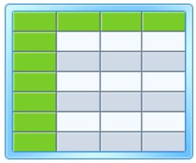

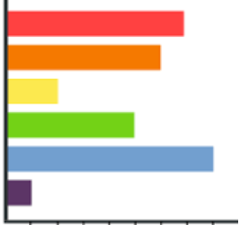
Avant de commencer…
Nombre de
tournages total
Tournages par géographie
Arrondissements,
années
Evolution du nombre de tournages en fonction du temps
Durées de tournages selon mois
Top 10 réalisateurs
Notes:
First thing I had to do was to understand the report. If I had to build it myself from scratch, I would have to ask myself those questions and come up with the answers.
- Understand who uses it (client + BLX contract managers)
Understand its structure
Understand its content
Hence, understand its aims/objectives/reasons of being = give ‘managers’ an overview of the 1) the volumes and 2) the ability to clear and deliver on time and 3) if there are some delays, to understand their causes. → There is already a hierarchy which is visually implied in this dashboard and this is very good.

Slide 45
Avant de commencer…
Transformer
Se connecter
1 fichier
Localisation ➔ C:/
Enlever les 2 premières lignes
Utiliser la 1e ligne comme en-tête
Modifier les types de colonnes

Slide 46
Avant de commencer…
Calculer
Information | Calcul | Contrôles Qualité
Dates de début de tournage | Durée des tournages | Est-ce que toutes les lignes comportent la donnée? Taux de non remplissage Taux d’erreur
Coordonnées GPS (latitude, longitude) | Localisation
Notes:
It that all? No! I need to understand how each information is produced
Hence understand and define how each indicator is calculated :
Based on which calculated column, how are they evaluated, etc.
Which Quality controls can be made on the key fields on which the KPI evaluation depends?

Slide 47
Avant de commencer…
Partager
Notes:
Sharing modalities:decided I would share:
the .pbix file
On Service + App : the report and a dashboard

Slide 48
Maintenant nous pouvons commencer

Slide 49
Power BI Desktop
D’où l’on construit nos rapports

Slide 50
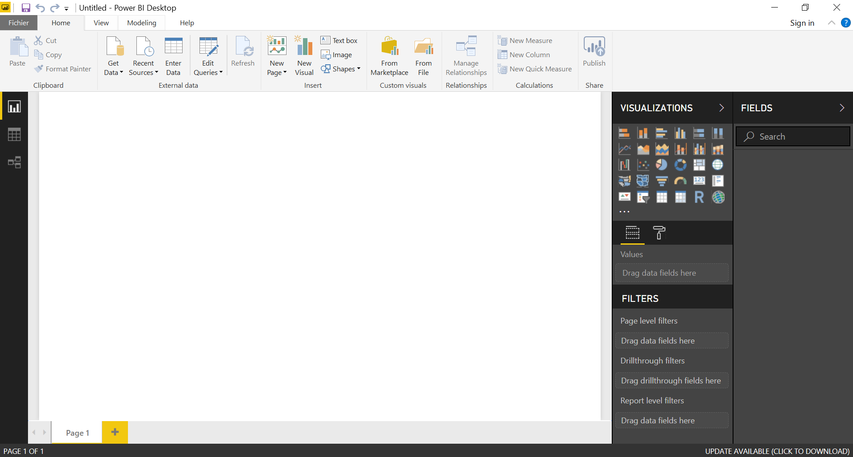

Notes:
Dérouler l’exemple

Slide 51
va booster votre quotidien
Comment
Notes:
Im not asking ‘why’ cause I know it will → I’ll explain to you how
It is going to change YOUR life, but also your colleagues’ + your clients’

Slide 52
Se connecter

Slide 53

Notes:
Video en vitesse rapide

Slide 54
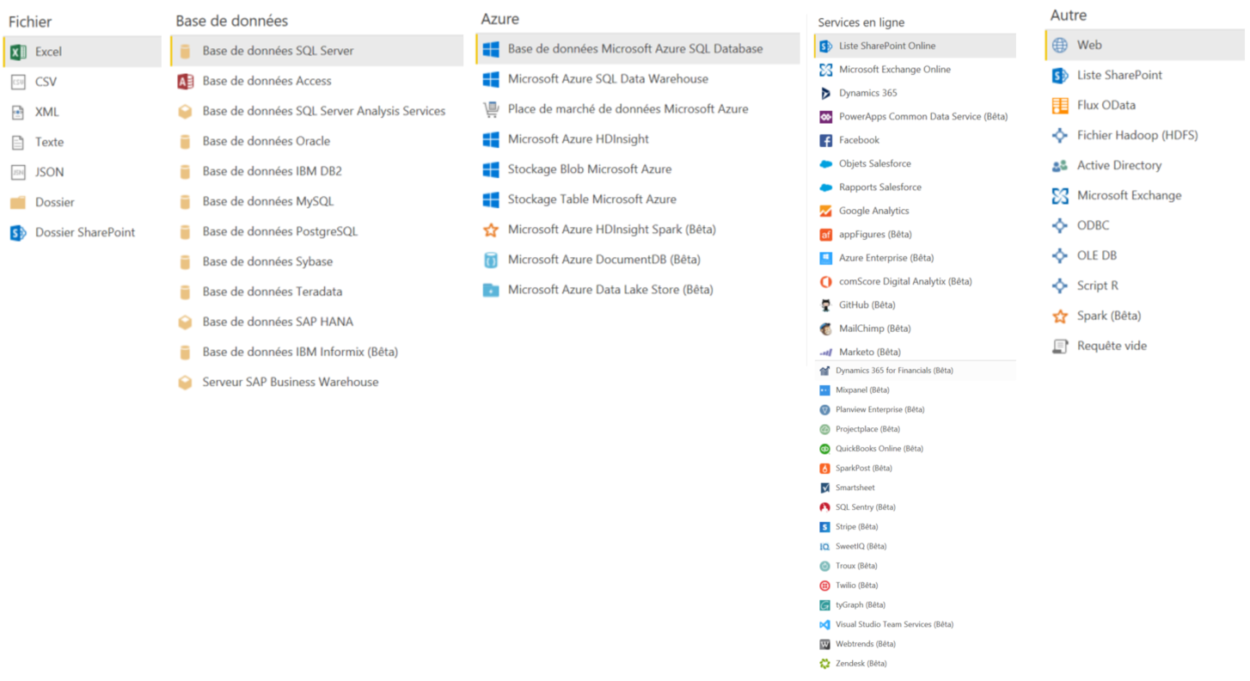
Des sources de données variées

Slide 55
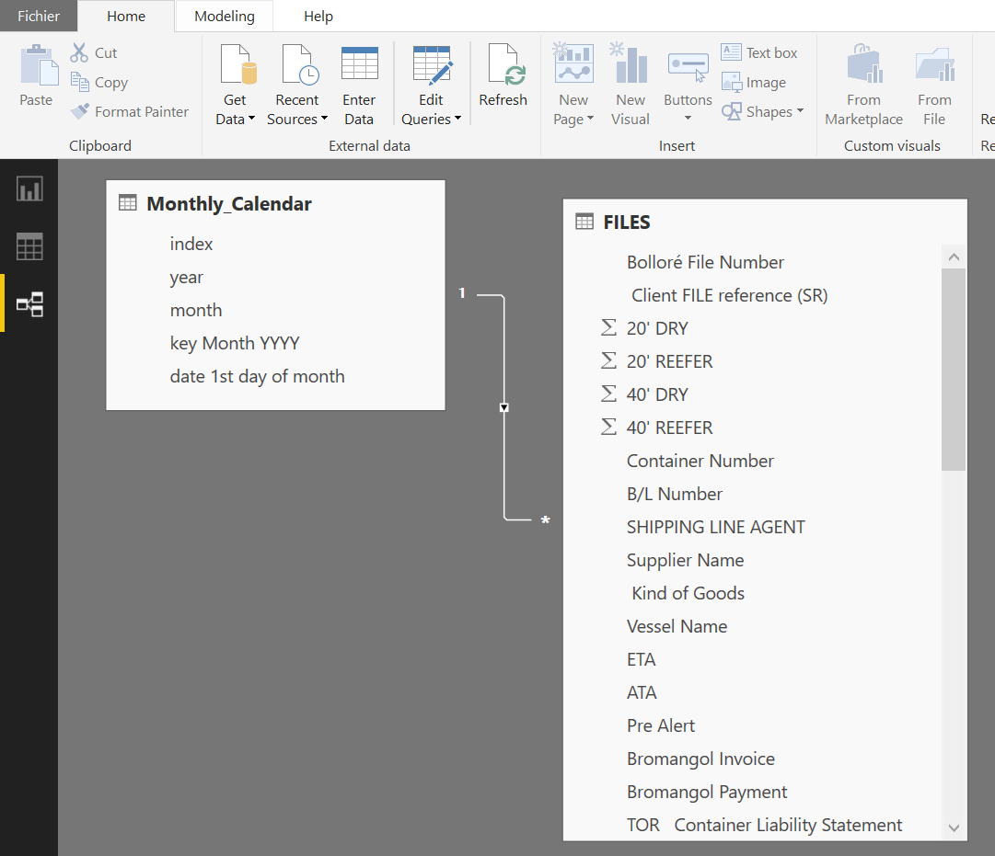
Modèle relationnel facile d’utilisation
Notes:
Now that we have loaded and transformed our data as we wish, we can easily link our tables together and manage the relationships.

Slide 56
Transformer

Slide 57
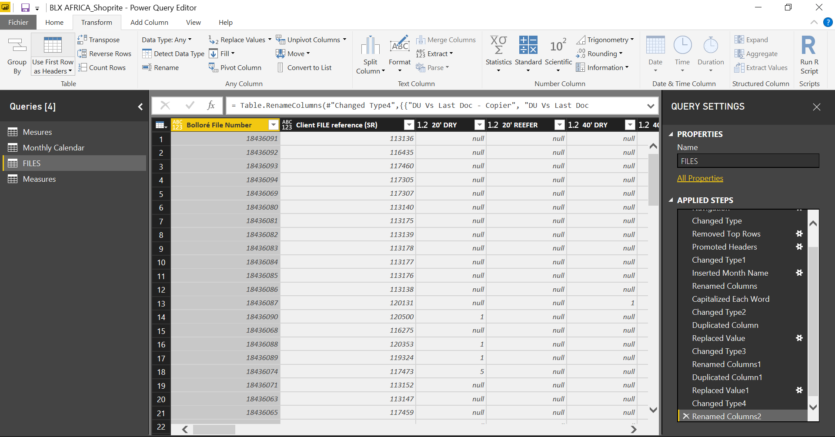
Transformations rapides et automatisées
Notes:
Individual actions automation

Slide 58
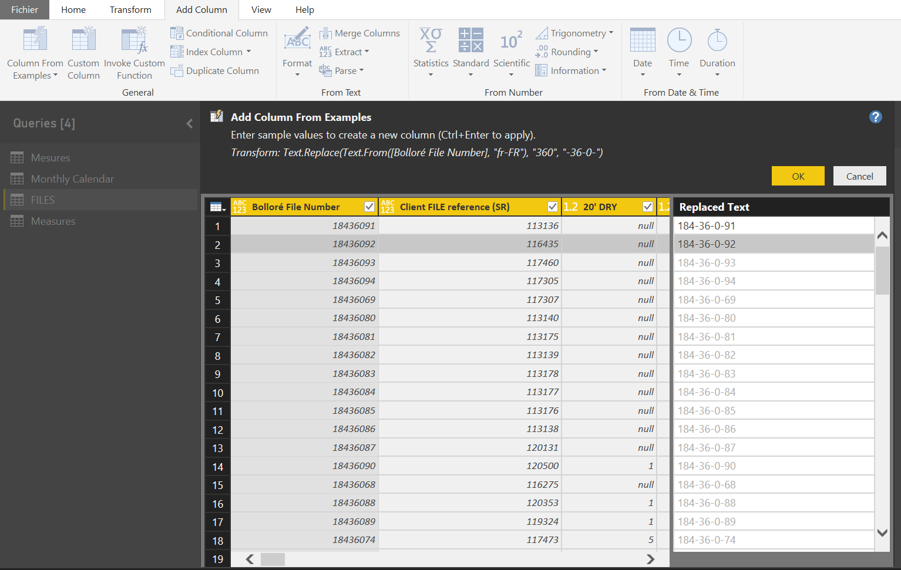
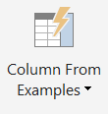
Magique!
Ajouter des colonnes à partir d’exemples
Notes:
What if you don’t have to write formulas ever again? Why not?!
You can also do this not only for transformations but also for calculations.

Slide 59
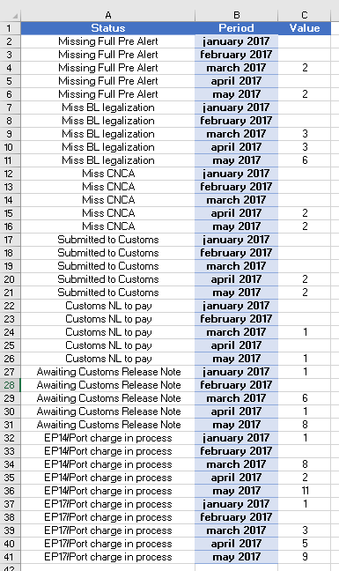
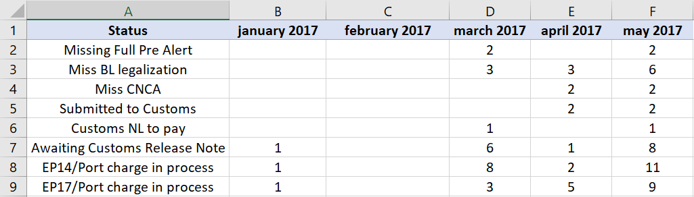
Transformer des tables 2D en tableaux 1D

Slide 60
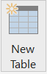
Facilement créer des tables à partir d’autres tables

Slide 61
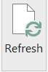
Mettre à jour les données
Ré-appliquer les étapes de transformation
Mettre à jour les calculs
Rafraîchir son modèle en 1 clic

Slide 62
On ne peut agir sur les données source
Notes:
Let’s hope no one is color-blind
It’s a one-way link.

Slide 63
Attention aux changements de structures
(renommage de colonnes,…)
Notes:
Let’s hope no one is color-blind

Slide 64
Calculer
Notes:
Let’s move on to step 3.

Slide 65
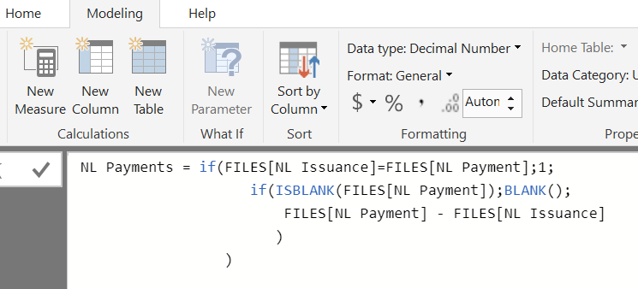
DAX est intuitif
DAX permet l’indentation
La librairie de fonctions s’applique sur des modèles de données
Notes:
DAX = library of functions. Designed to be performed on relationships models VS excel.
Let’s run some calculations. (calculated columns + measures).
Such things are expressed in DAX (library of functions). I want to show you how it works.

Slide 66
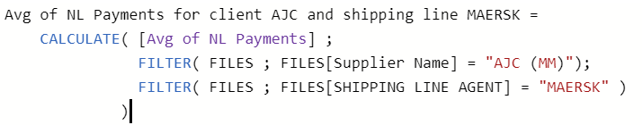
Facile à lire
Fonctions puissantes
Permet de nommer ses calculs
Permet le référencement
Notes:
Excel =
no name to your calculation
Can’t reevaluate another calculation and apply some filters to it (=change the calculation context)

Slide 67
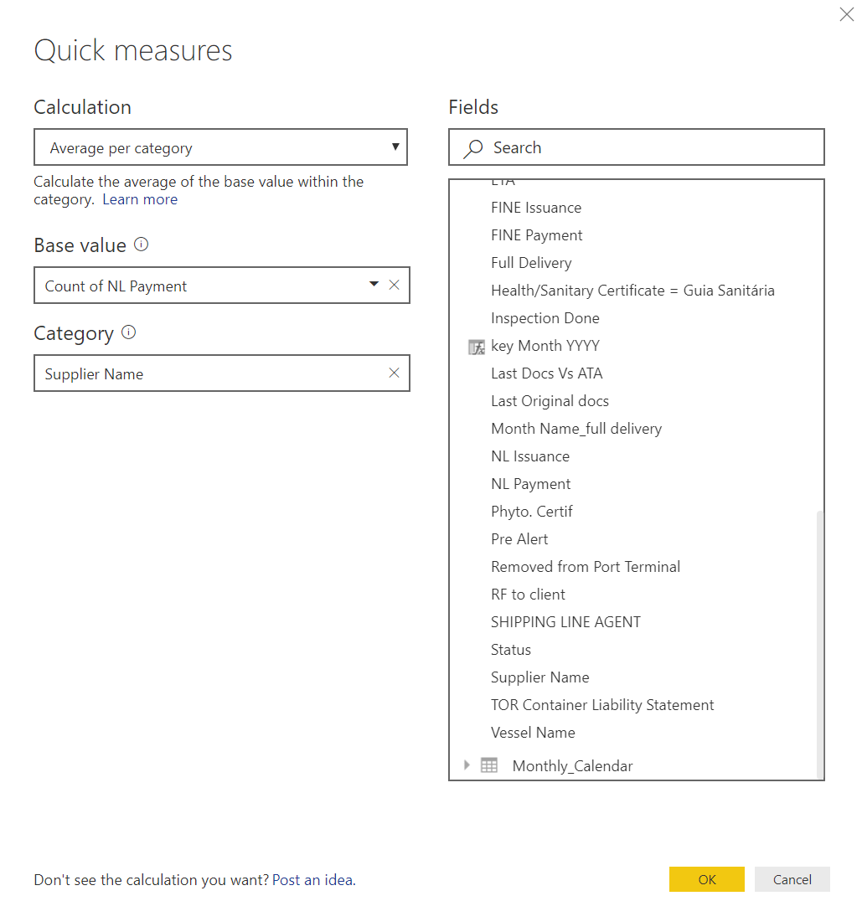
DAX en tant que self-service

Slide 68
Licence Auteur et Pro = 10 Gb
Capacité de chargement & stockage
Notes:
>100 000 rows is not a problem
Example: KC = >1M, 128MB / 10GB
++ no need to manage ‘historical data’. It’s not a problem if in 1 report you have data 2010-2018, you can still use it. No need to slice it up. All you data is in 1 place.

Slide 69
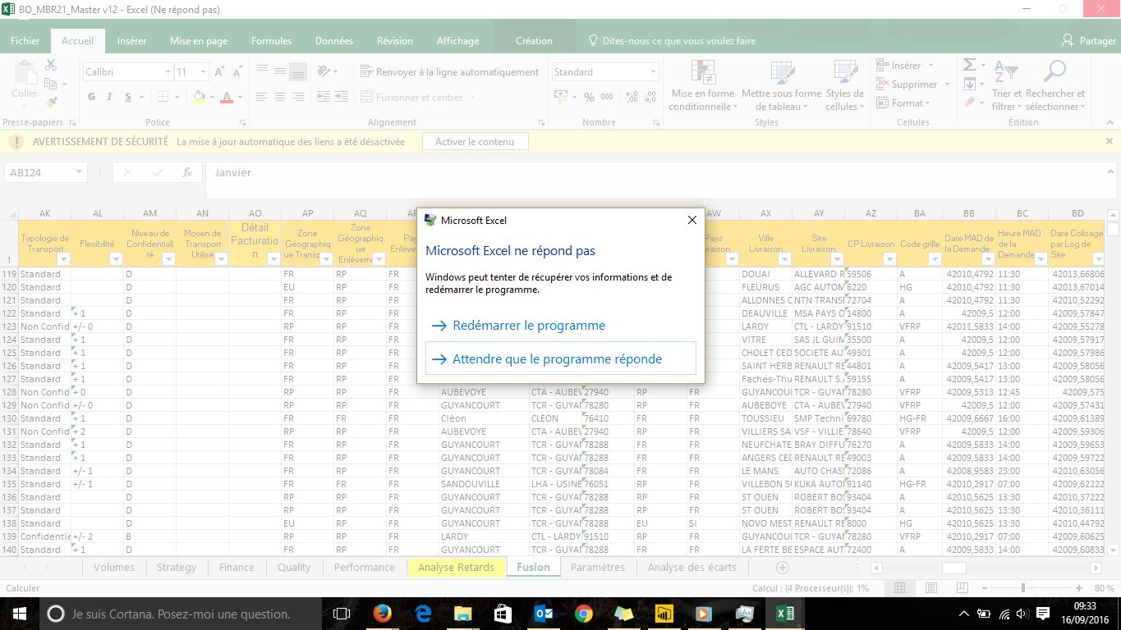
Agréable rapidité de calcul
Notes:
Visually, everything is not loaded (it is loaded as you scroll down)
>3 seconds = too long for Microsoft, your model is probably shaky

Slide 70


Analyses avancées avec R ou Python
Notes:
R = mathematics, advanced statistics, customed visuals,…
Python = Machine learning,

Slide 71
Visualiser
Notes:
step4

Slide 72
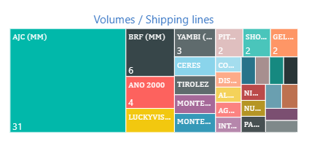
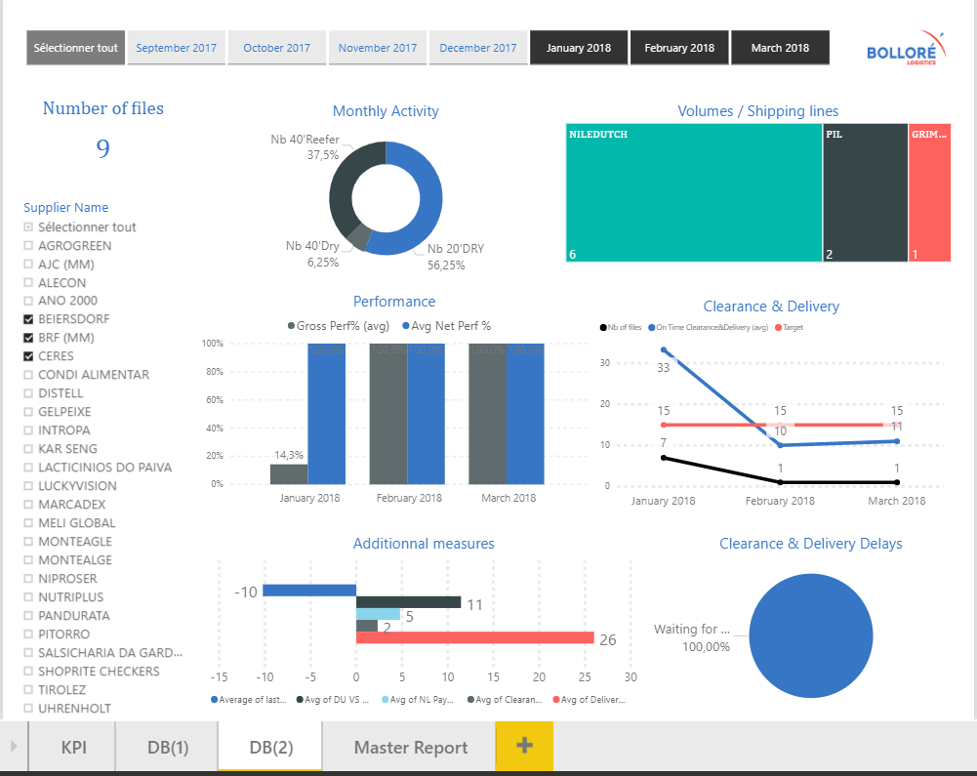

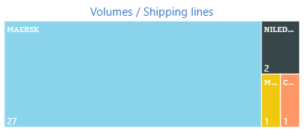
Volumes per clients
Volumes per suppliers
Faire prendre vie à ses données
Zoomer/dézoomer
Les hiérarchies
Notes:
Facilitates multi-dimensional / milti-criteria analysis

Slide 73
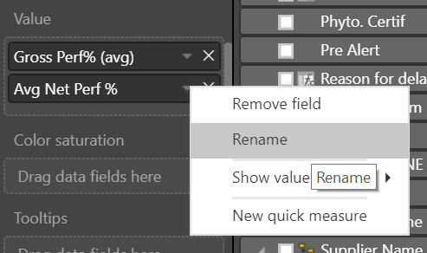
Renommez vos calculs avant de les afficher

Slide 74
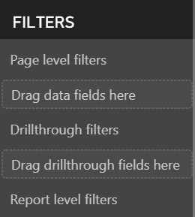
Plusieurs niveaux de filtres

Slide 75
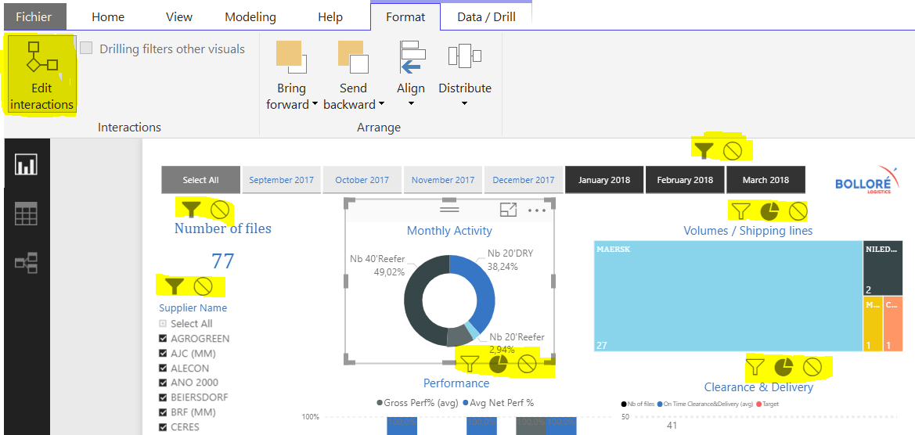
Les interactions entre les visuels sont paramétrables

Slide 76
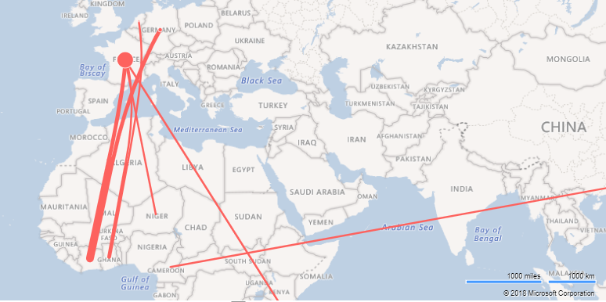
Bons outils cartographiques

Slide 77
Visuels customisés
Notes:
Import liquid gauge + Avg gross perf raw_percent.
Then open visuals done.

Slide 78
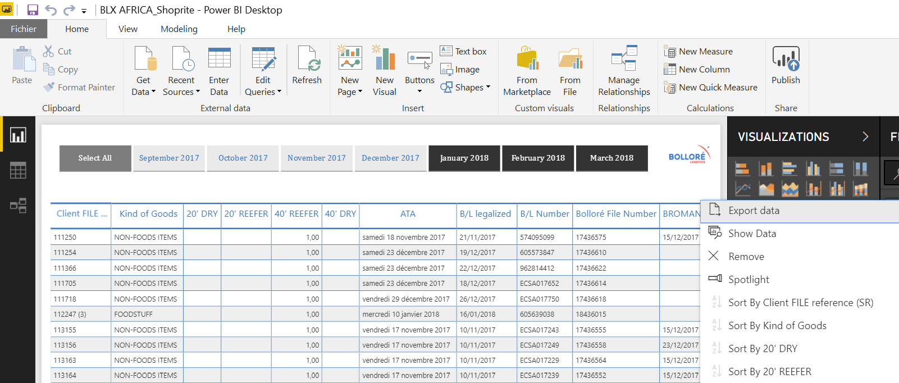
Exporter vers excel

Slide 79
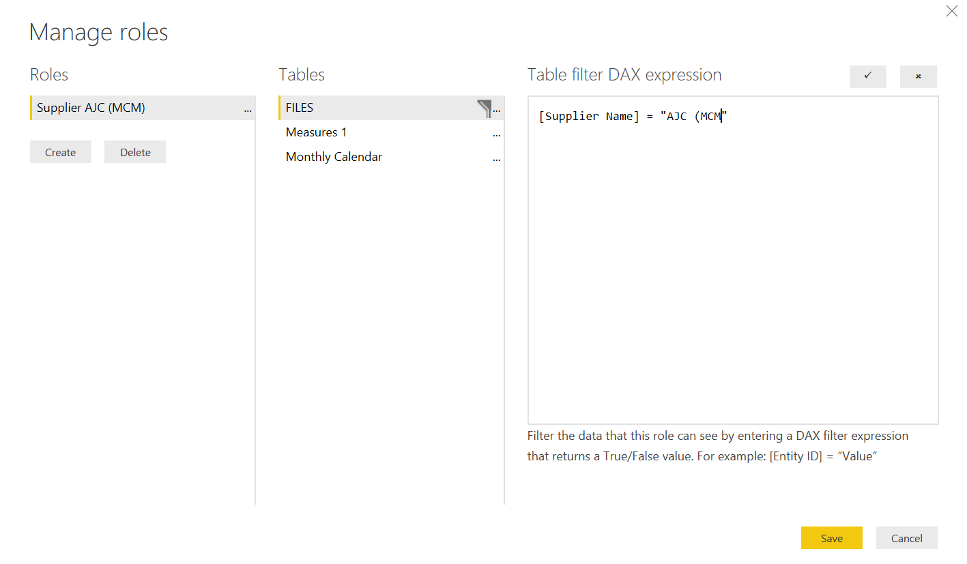

Donner différents accès à l’information

Slide 80
Partager
Notes:
Step 5

Slide 81


Facile à partager
Souscrire à des notifications sur les rapports
Rafraîchir les données depuis le Service
Notes:
Everyone has the same version at the same time.
No email to send cause people can subscribe to the reports and get an alert whn updated.

Slide 82
est statique
Besoin d’un compte Power BI
est public
Notes:
Public link = the embed code can be desactivated each month and replaced by a new one.

Slide 83

Dashboards:
Les tuiles ne sont pas interactives.
Notes:
Not interactive = if you have a pinned element which is a slicer, if you click on it and select 1 element, it won’t update the other ones.
That’s because DB = to consult figures.
N.B. if you pin an element from the report as a filter is applied, the pinned element will keep this filter context.

Slide 84

Rafraîchissement automatique depuis le Service :
Besoin de paramétrer des passerelles
(règles DSI)
Notes:
Gateways setup (2 types : local and when you connect to a more complex server). When within a business context, it’s often « complicated » to install and set them up because of IT rules which block the execution of the installment of such gateways.
BUT since your data seems to be updated monthly, you can always refresh from the desktop and publish (2 minutes)

Slide 85


Annoter
Mettre en place des alertes

Slide 86




Infos rapides
Inspecteur de performances
Q&A
Métriques d’utilisation
Fonctionnalités du Service
Notes:
Usage metrics → depuis le rapport
Performance inspector → depuis le dashboard

Slide 87
Report 1
Dashboards:
Vous pouvez rassembler des éléments provenant de différents rapports
Report 2
Quick insights
Q&A anwers
Notes:
Pin elements to an existing DB.
DB = can bring the information of several reports together.
Get an overview of several accounts for example.

Slide 88


La communauté
Templates disponibles
Notes:
2 sources
Try the bing one?

Slide 89



La communauté
documentation
forum
idées

Slide 90

Déploiement rapide…
Notes:
Fast deployment because intuitive tool.
/!\ the needs/ requirements specifications must be precise and set up/precisely expressed.
When you know exactly what you have to do, deployment is quick.

Slide 91

… qui peut être réalisé par des professionnels non experts en data
➔ Réduction des coûts
Notes:
Fast deployment because intuitive tool.
/!\ the needs/ requirements specifications must be precise and set up/precisely expressed.
When you know exactly what you have to do, deployment is quick.

Slide 92
dans votre entreprise
Mettre en place
Notes:
Im not asking ‘why’ cause I know it will → I’ll explain to you how
It is going to change YOUR life, but also your colleagues’ + your clients’

Slide 93
Définissez le besoin
Présentez Power BI
→ servez-vous de ces slides
Appuyez sur les points forts ☺
Proposez 1 test sur 1 projet simple
Proposez un agenda + 1 budget
Go!

Slide 94
Pas besoin d’experts BI
€ + temps
efficience
Facile à lire & partager
1 rapport, plusieurs sources
Image de marque
Forces
Stratégiques
Infos rapides
auto-refresh
Monitoring proactif
Prise de décision rapide
Interactif + dynamique
Notes:
Save time + $ == focus on value-added tasks. You spend less time compiling your raw data.
Win-win situation! More time for your client!
No need for BI experts == lowers upfront costs + design your report as you wish (easy and quick to modify).
Clients = allow them to go get the information they need (using filters and so on) instead of asking you for some specific figures and numbers. == everybody saves time!
Easy to read and share = no need to send excel files, which are too big by email and so on.
1 report, many sources = 1 place where all the information is gathered.
Interactive + dynamic = drill down, get the information you need. Take a walk in your data, there is sthalmost poetic about it!
Make quick decisions = the whole report-building process is quicker, you get it more frequently thus you are more reactive, you can make quicker decisions.

Slide 95
Comparaisons historiques
Capacité de stockage et chargement
Colonnes calculées basées sur des exemples
Sources variées
DAX
Se connecter
Calculer
Forces
pratiques
ETL facile
Refresh = 1 clic
Transformer
Mesures rapides
R & Python
rapidité
2D to 1D
Notes:
Easy ETL : can do a lot without typing formulas.
DAX = easy to read, powerful functions (no details), indentation, give names to your measures.
Quick measures = select arithmetic operations to perform instead of typing your formula.

Slide 96
communauté
Interactif & dynamique
Visuels customisés
Publier & jouer
Visualiser
Forces
pratiques
Share
Refresh depuis Service
Q&A, insights, métriques d’utilisation
annoter
roles
Ajuster les interactions
alertes

Slide 97
Best practices and metrics
Notes:
Some xtra stuff: personnal pieces of advice:

Slide 98
Définir avant d’agir.
Utiliser un template. Réaliser les étapes avec méthode.
Contrôler la qualité de vos données.
Calculs = définir + nommage explicite + indentation + référencement.
Formaliser.
Notes:
Do the pre-requisite work

Slide 99
Timing…
Besoins | Data model | Calculations
Clairs et définis | 1 table | Simple (Sums, avg,…)
En évolution | [1..3] tables | Intermediaire (VAR, YTD,…)
Obscurs et en évolution | >3 tables | Complexe (calendriers spécifiques, …)
Notes:
3 factors to take into the equation.
- Clarity of the needs (documented? Clear? Evolving?)
- Size of the data model (by experience, multiple facts table = necessity to build extra tables, bridge tables = more complex model and calculations)
Level of complexity of the calculations
Dimension table, standards, baseline. Ex : geographical referential = list of cities + zip codes + associated latitudes and longitudes.
My metrics = a report like Shoprite = 1,5 days. (quick because I don’t have to understand the data and the needs, it’s already there)

Slide 100


VS
Automatisation des actions individuelles
Besoins de douzaines d’actions individuelles
Multiplicité des sources de données (>70)
Intégrer des données de différentes sources est compliqué
Visuels dynamiques
Haute capacité de stockage
Excel n’est pas approprié pour le ‘Big data’ (>100 000 rows)
Fonctions innovantes et puissantes
Importante vitesse de calcul
Facile à partager

Slide 101
The End

